Slide 1
The Synthesis Reactor Methanol
Anna Boese • Giacomo Bristot • Louie Nyeland • Nikolas Vitaliti • Rúna Brimnes • Theodora Dragani

Slide 2


Methanol synthesis from CO
⇌
$2H_{2}+CO$
Synthesis from CO or CO_2
Production by:
Coal gasification
Natural gas reformation into syngas
Good fuel for gasoline engines
Combustion in diesel engines possible
$$CH_{3}CO$$

Slide 3
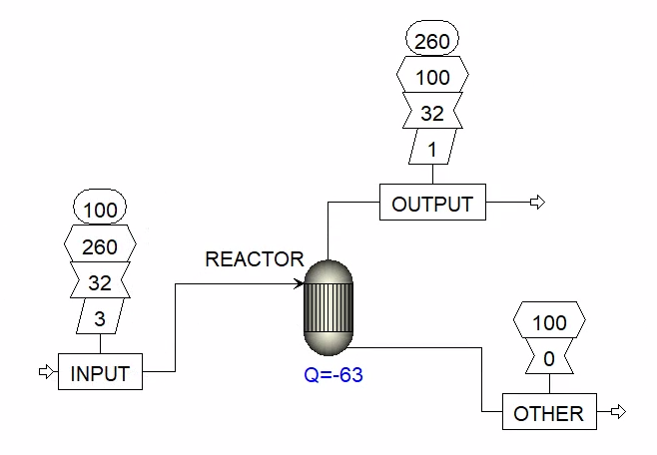
Aspen Plus Setup

